Slide 1
Run2-TDC Dataformat
Su-Yin Grass Wang, Jin-Yuan Wu, David Christian Da-Shung Su and Wen-Chen Chang

Slide 2
Register Map
0x000 version number (e9061212)
0x004 CSR
0x008 test area =0xaaaaaaaa
0x00c
BLKS(26-24) |DeMultiDD(23-16) |CR_Reset(15) | CR_Clear(0)
0x010 0xe906e0## = # of events
0x014
Time Window On(31)
UP_LIMIT(25-16) | LOW_LIMIT(9-0)
0x030 –Time window Check
0x1000~0x1ffc = event buffer (1k internal)
0x2000~0x2ffc = test area
D31-D16 | D08 | D7-5 | D2-0
EN4X (CSR) | BothEdge (Edge selection) | SEL(READ/WRITE addr) | M (buffer size)

Slide 3
Configuration
Event table
Adjustable
Time window width
CIP time
Event Buffer
Adjustable
buffer size
number of buffer
CSR [7:5] | Number of Circular Buffers | Circular Buffer Size (MB) | Buffer Timing Window | CIP Time
000 | 8 | 32 | 512 ns (-256 ns) | 32 x 16 x 16 ns = 8 us
001 | 4 | 64 | 1024 ns (-256 ns) | 64 x 16 x 16 ns = 16 us
011 | 2 | 128 | 2048 ns (-256 ns) | 128 x 16 x 16 ns = 32 us
CSR [2:0] | Number of events | Max. number of words/event
5 | 32 | 32
4 | 16 | 64
3 | 8 | 128
2 | 4 | 256
1 | 2 | 512
0 | 1 | 1024
Notes:
These buffer size corresponding to hit accepting window of 512, 1024 and 2048 ns. Due to effect of the RegPipe4a, the 100% hit accepting windows are 256 ns narrower.
The 256 ns here is the part close to the trigger of TDC. Since our trigger is delayed by 700us, we may not care.

Slide 4
Scalar
TC[8..3]
62
63
0
1
2
3
4
5
TC[2]
TCQ[8..3]
62
63
0
1
2
3
4
5
TCQ[2]
SE[1]
SE[0]
QS[7..0]
CH0
1
2
3
4
5
SEL=TC[2]
ADDRA[5..0]
=TC[8..3]
(for read)
62
63
0
1
2
3
4
5
ADDRA[5..0]
(for write)
62
63
0
1
2
3
4
5
Write
(inv. RWA)
=TC[2]
8 buffers for scalar
0x00c , BLKS(26-24)= buffer (0~7)

Slide 5
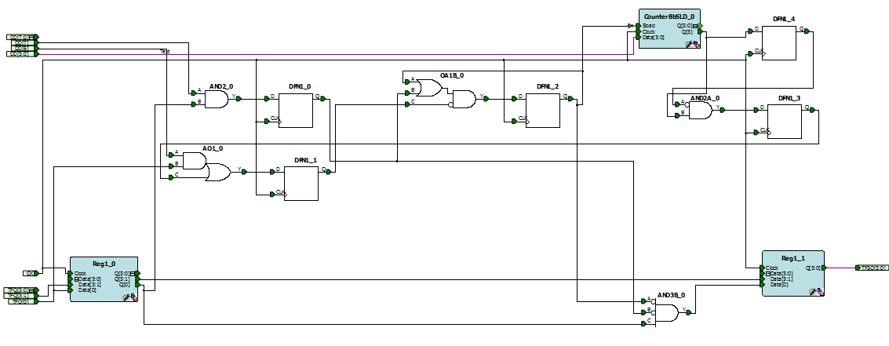
Multiple Hit Elimination
TFQ[0] (Data valid)
DD is the register controls multiple hits elimination.
DD[7]
=1: Eliminating Multiple Hit
DD[6]
=1: Updating Mode
=0: Non-updating Mode
DD[5:0]
0-63: Number of cycles of multiple hit elimination. 4ns*(4+DD[5:0])
(updating mode 0-31 only)
Reg1_0_Q[0]
DFN1_1_Q
(DFN1_2Off if DD[6]=1)
DFN1_0_Q
(DFN1_2On if DD[6]=1)
DFN1_2_Q
Q[5:0]
X
3
3
2
1
0
3F
3E
3D
3C
3
DFN1_3_Q
Hits from Reg1_0_Q[0] are blocked in this region.

Slide 6
Multiple Hit Elimination
In register map : 0x00c
BLKS(26-24) |DeMultiDD(23-16) |CR_Reset(15) | CR_Clear(0)
DeMultiDD (5-0) length of Inhibit : 0-63: Number of cycles of multiple hit elimination. 4ns*(4+DD[5:0]) (16 – 272 ns)
(updating mode 0-31 only)
DeMultiDD (6) update mode/NON –update mode
DeMultiDD (7) Elimination on/off
Raw data
Inhibit
TDC recorded

Slide 7
DATA format
Header
D15 | D14 | D13 | D12 | D11 | D10 | D09 | D08 | D07 | D06 | D05 | D04 | D03 | D02 | D01 | D0
Trig [13:4] (trigger time) |  |  |  |  |  |  |  |  |  |  |  | Fine time
D31 | D30 | D29 | D28 | D27 | D26 | D25 | D24 | D23 | D22 | D21 | D20 | D19 | D18 | D17 | D16
1 | CNT[10:0] (number of hits) (could indicate truncated data readout ) |  |  |  |  |  |  |  |  |  |  | 0 | 0 | 0 | 1
Fine time = 0~8, ~444ps
TDC = 4 ns
Data
D15 | D14 | D13 | D12 | D11 | D10 | D09 | D08 | D07 | D06 | D05 | D04 | D03 | D02 | D01 | D0
TDC [13:4] (data time) |  |  |  |  |  |  |  |  |  |  |  | Fine time
D31 | D30 | D29 | D28 | D27 | D26 | D25 | D24 | D23 | D22 | D21 | D20 | D19 | D18 | D17 | D16
Cable: 4,5,6,7 |  |  |  | Channel number: 0-15 |  |  |  | hit number |  |  |  | 0 | 0 | 0 | positive or negative edge
Notes:
MSB = most significant bit

Slide 8
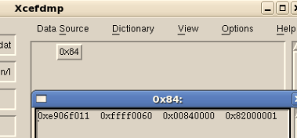
CODA raw data – FEE information event
0x84 (event type)
(0x84 may already used, could change to whatever more than 128 but not used)
0xe906f011 = FEE ID
0xffff0060 =TDC Reg(0x004)
0x00840000 =TDC Reg(0x00c) (Multihit Elimilation)
0x82000001 =TDC Reg (0x014) (Time window)

Slide 9

CODA raw data – physics event
Ignore every 0xe906e906 in DATA
boardID/ Num of word in TDC buffer
FEE type
header
Data
Dummy word

